Slide 1

React JS

Slide 2
Render Props
Module-

Slide 3
What is Render Props?
render props the term “render prop” refers to a technique for sharing code between react components using a prop whose value is a function
it is possible to use a prop whose value is a function to control what is actually rendered by a component
A container Component where we will implement the common functionality
A component with a render prop takes a function that returns a React element and calls it instead of implementing its own render logic

Slide 4
Component
RenderProp
props
Data
Value
callBackFunction
Passed to
Function
props
renderCallBack(this.data, this.Function)
The function reference is passed
<RenderProp renderCallBack =
{ (data, fnRef) =>
{ return <Component
Value={data}
callBackFunction = {fnRef}/>} } />

Slide 5
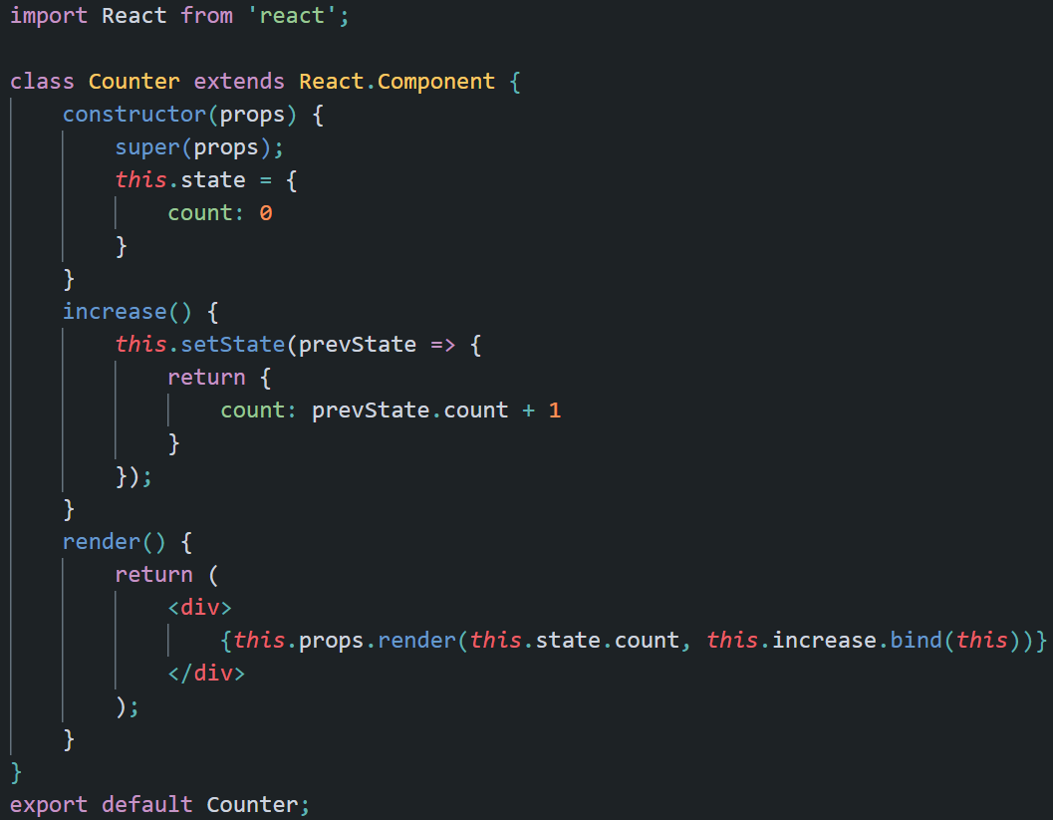

Slide 6
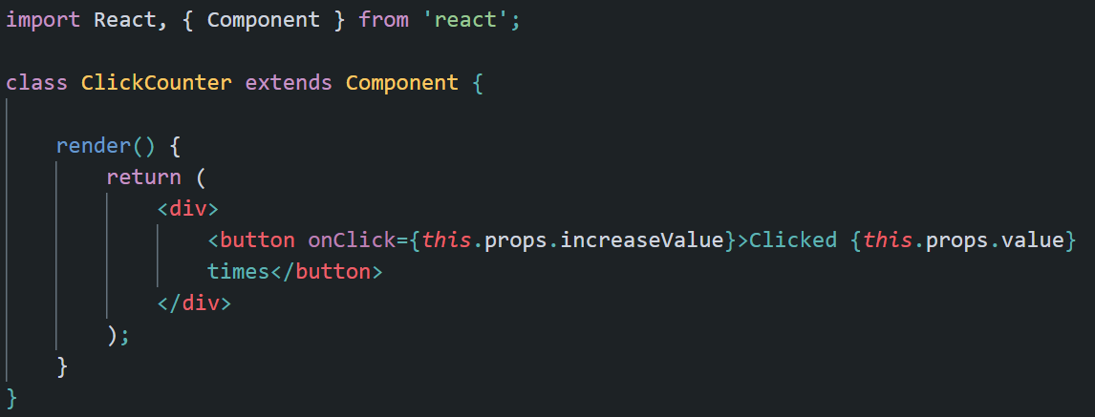

Slide 7
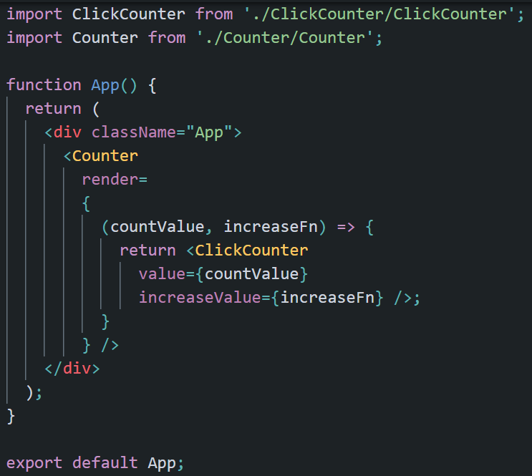

Slide 8
When to use RPC?
Use them when to reuse component logic and
To abstract away imperative code to provide a easier to understand declarative API

Slide 9
HOC vs RPC
The React community is moving away from HOC (higher order components) in favor of render prop components (RPC)
For the most part, HOC and render prop components solve the same problem
However, render prop components provide are gaining popularity because they are more declarative and flexible than an HOC
For more, refer the following link:
https://gist.github.com/heygrady/f9bf3b6dd93fe3d87ba87430fd3c20d5#:~:text=The%20React%20community%20is%20moving,and%20flexible%20than%20an%20HOC.

